Slide 1



CLIMATEWINS:
CLIMATE CHANGES PREDICTION
By Rose Alappat Joy

Slide 2

Objective
ClimateWins aims to use machine learning to predict the impacts of climate change across Europe and potentially worldwide
Hypothesis
Machine learning can predict the effects of climate change using weather data.
Machine learning models could have ethical issues, like bias or lack of transparency
Machine learning can predict whether the weather will be good or bad on a specific day.

Slide 3
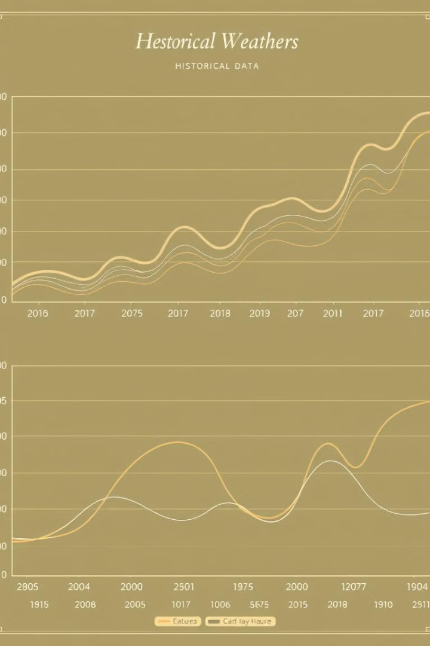
Data Source & Bias
Data Origin
The European Climate Assessment & Data Set project provided the primary dataset, which includes comprehensive weather observations from 18 weather stations across Europe, meticulously recorded from 1960 to 2022..
Data Variety
Includes temperature, wind speed, snow, and global radiation
Data Bias
Collection Bias: Variations in instrumentation, measurement techniques, or the relocation of stations over time can lead to biased data.
Sampling Bias: Gathering data from only 18 specific stations out of
26,321 across Europe may result in an unbalanced representation of climate patterns.

Slide 4
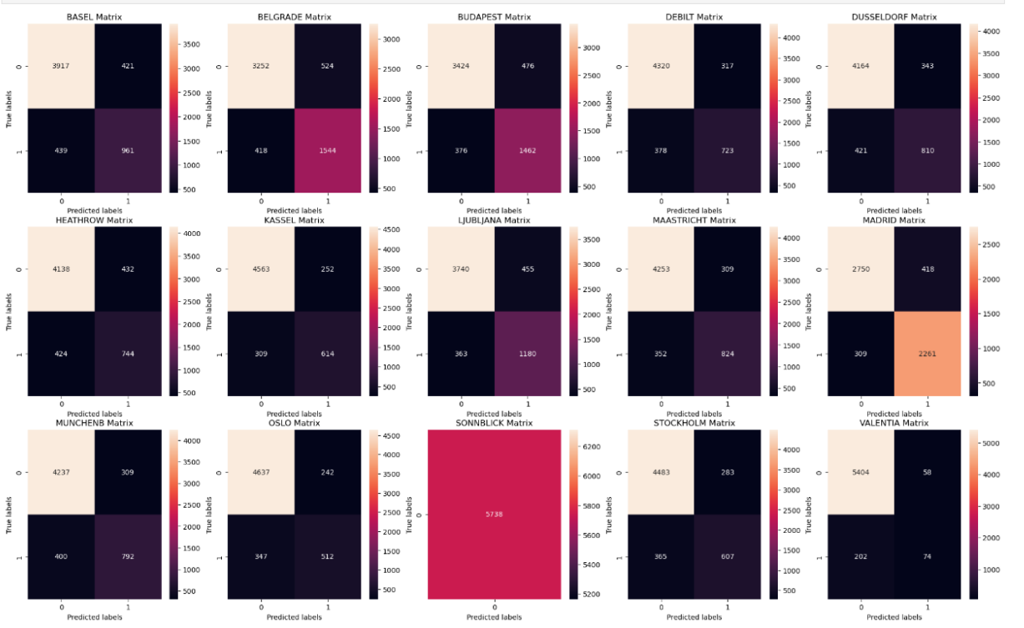
Supervised Learning: K-Nearest Neighbor
The K-Nearest Neighbours (KNN) algorithm, a supervised machine learning method is used here, which classifies data points based on their distance to nearby points in other categories.
Weather Station | Accuracy Rate
Sonnblick | 100%
Oslo | 90%
Basel | 85%
Average Accuracy | 88%

Slide 5
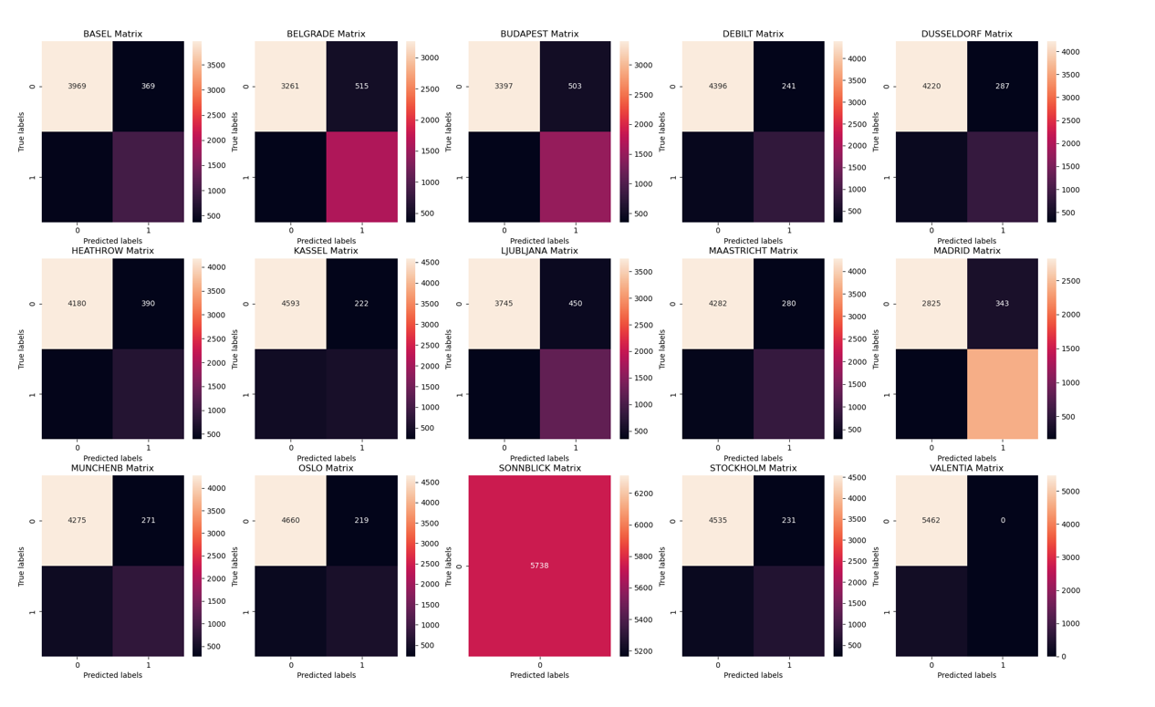
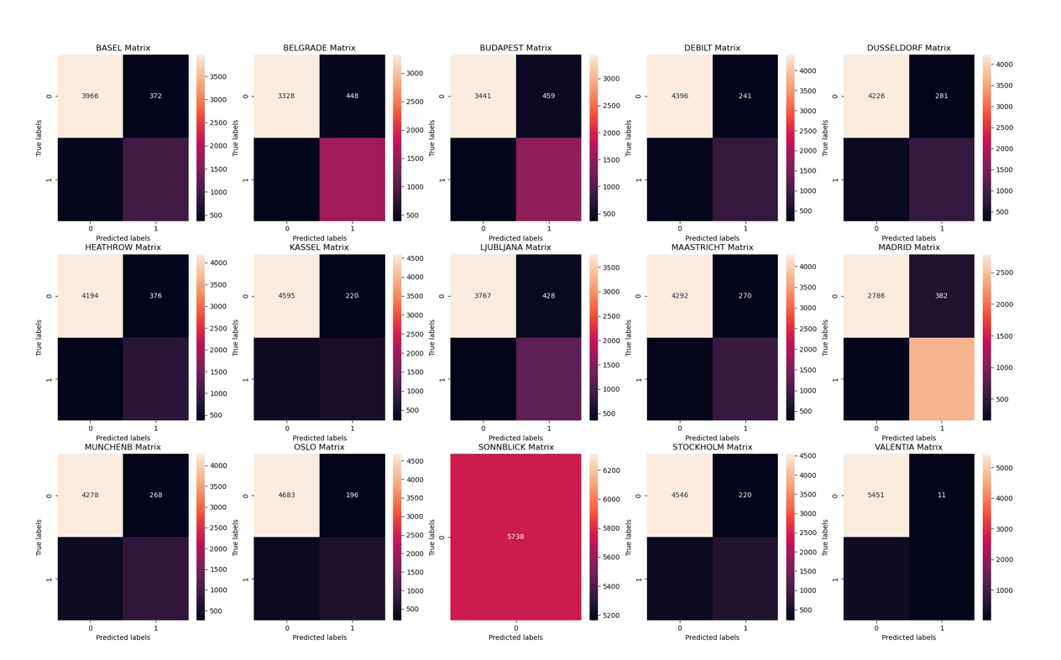
Artificial Neural Network (Confusion Matrix)
We used an Artificial Neural Network (ANN) to identify complex patterns in large datasets, achieving 50% accuracy, which reflects the challenges of predicting the unpredictable nature of weather
Test 1 (45.5% Accuracy)
Test 2 (47% Accuracy)

Slide 6
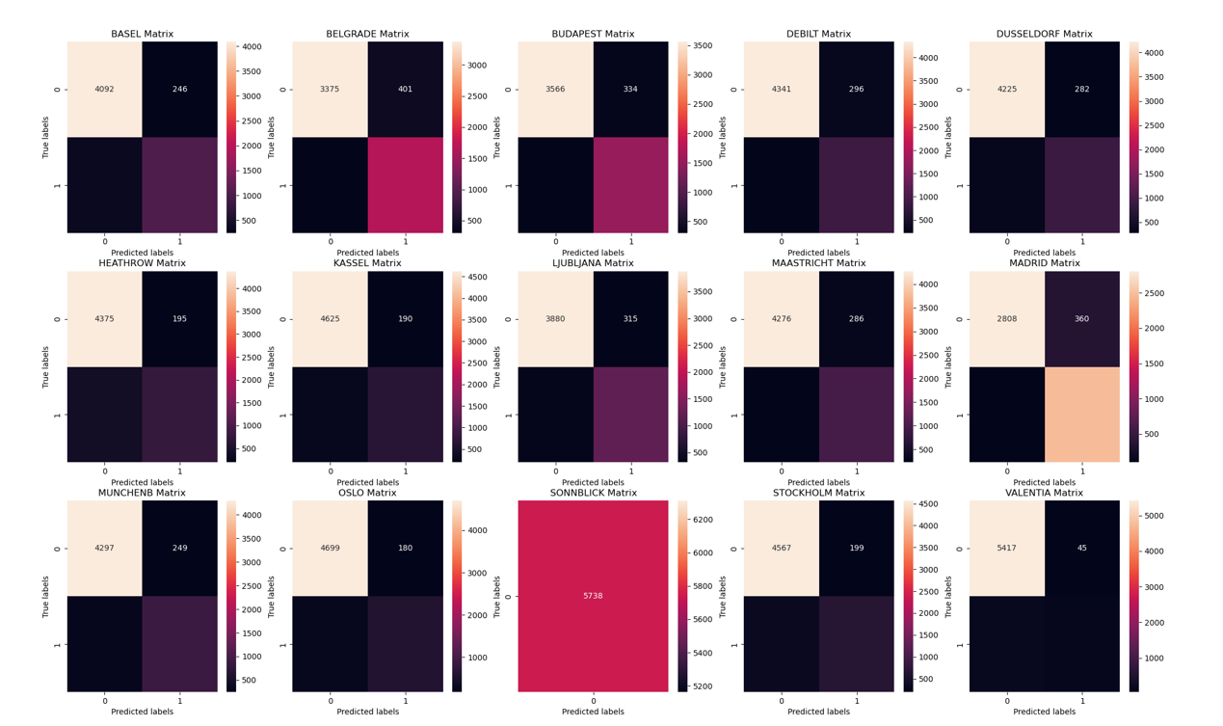
Artificial Neural Network (Confusion Matrix)
Test 3 (50% Accuracy)
Optimal architecture and training
Minimize FP,FN
Maximizing TP,TN
FP- False Positive
FN-False Negative
TP- True positive
TN-True Negative

Slide 7
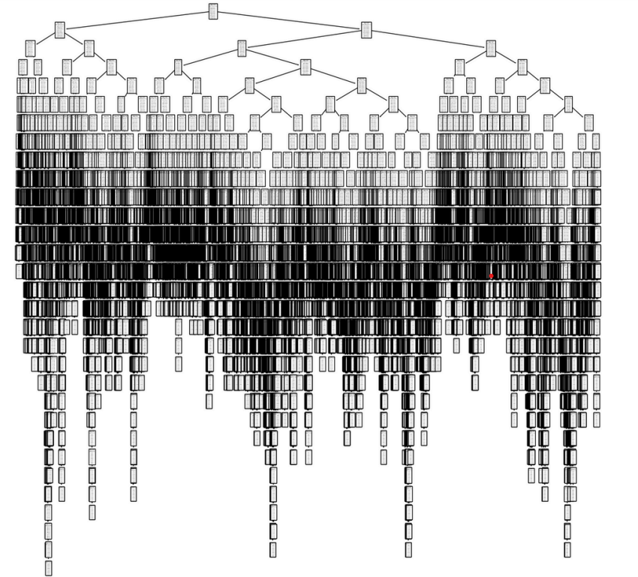
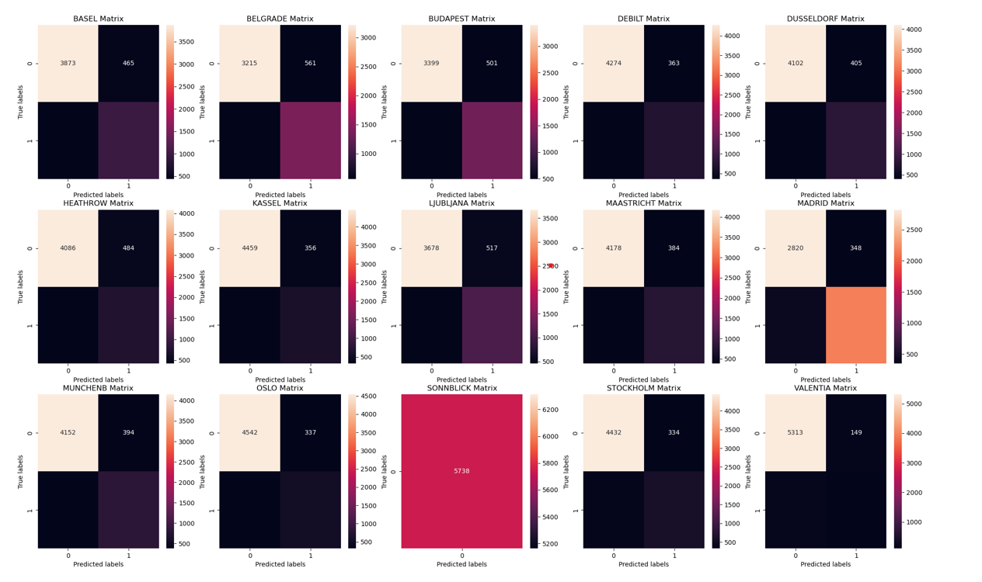
Decision Tree
Test set- 46% Accuracy
The decision tree needs to be pruned as it is too deep and complex

Slide 8
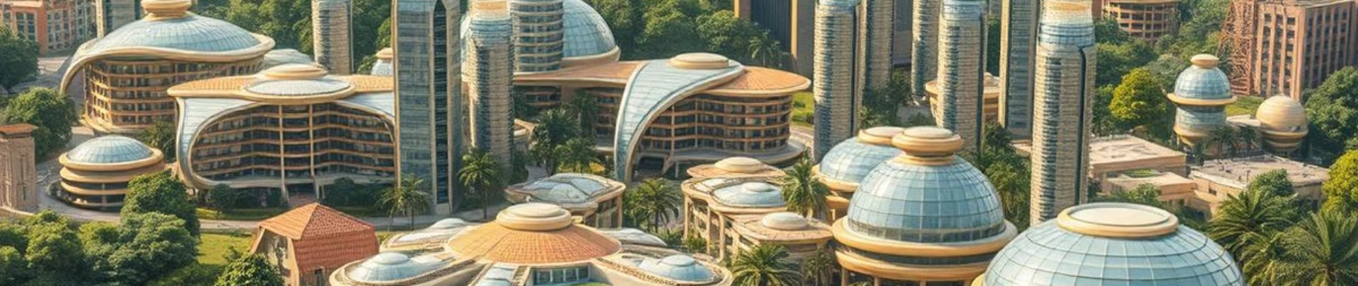
The KNN algorithm achieved the highest performance with an average accuracy of 88% on the test set.
The decision tree requires pruning to improve its accuracy.
The ANN demonstrated a maximum accuracy of only 50%
Therefore, KNN is the best model for weather prediction in this dataset
Conclusion

Slide 9
Future Directions
1. Model Integration
2. Decision Tree Pruning
3. Future Exploration
We will use uncategorized data and unsupervised learning to find patterns and improve weather predictions.
Future research will focus on combining models like KNN and ANN to create a more robust and accurate climate prediction system
We will apply pruning techniques
to optimize the decision tree,
simplifying its structure to prevent
overfitting and improve accuracy
on new data.
.

Slide 10
Thank you
Rose Alappat Joy
Email : roseaj1510@gmail.com

